Slide 1
OS Security
Understanding principles for access control in operating systems. Maintenance of the OS - updating and disaster recovery. GPOs. Recovery planning.
Tue Becher

Slide 2
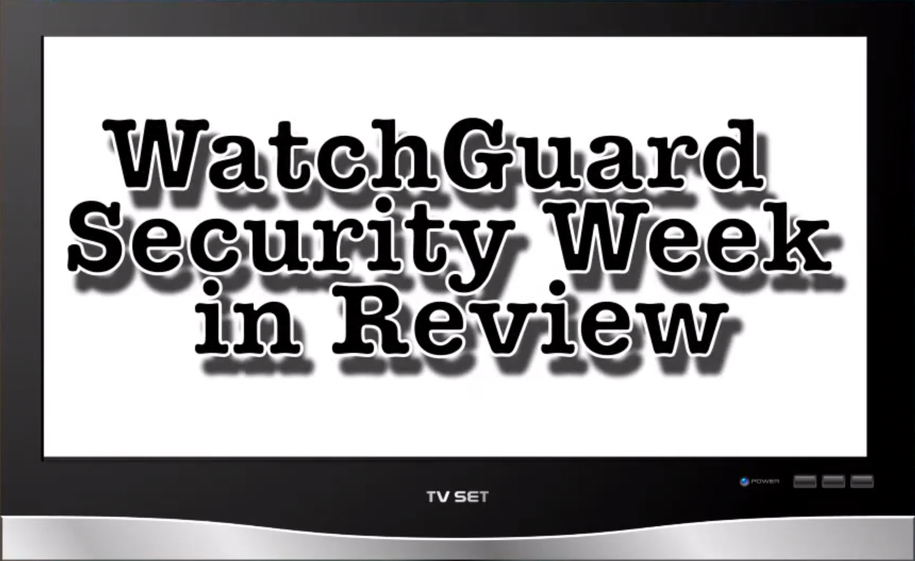
Security update
http://watchguardsecuritycenter.com/

Slide 3

Student presentation
Web Application Firewalls – by Thomas Juul

Slide 4
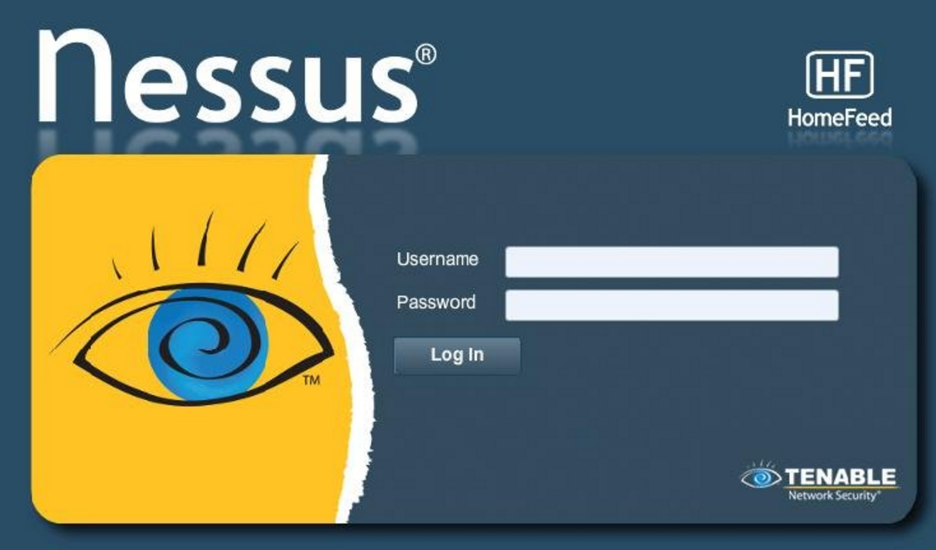
Student presentation
Nessus – by Amalie

Slide 5
Groups and roles
Help to clarify processes and administrate who have access to what…
Roles are defined for each job function
Access to functionality and data is assigned to roles
Users are given roles
No reason for a software developer to have access to the company billing system.
Self controlled teams may pose a challenge.

Slide 6
Access control
ACL – Access Control List
LUA – Least Privilege User Access
DAC – Dynamic Access Control

Slide 7
Access control
File access in Windows
Defined by access control lists (ACLs)
Describe rights for groups or individual users
Permissions are inherited from parent directories by default
Example:
Change access rights to a file / directory
Understanding how ACL works: http://book.cakephp.org/2.0/en/core-libraries/components/access-control-lists.html

Slide 8
Exercise
Create a low-privilege user
Create 2 files and change the access rights so that the new user can access one and but not the other
Verify
Win 10 hint: use “Local Users and Groups Manager” Start lusrmgr.msc via the Run Dialog [WinLogo+R]

Slide 9
LUA – Least Privilege User Access
Defined in the orange book as:
”(The Principle of Least Privilege) requires that each subject in a system be granted the most restrictive set of privileges (or lowest clearance) needed for the performance of authorized tasks.
The application of this principle limits the damage that can result from accident, error, or unauthorized use.”
Elevate rights based on needs
Don't run browser with admin privileges for normal use

Slide 10
UAC – User Account Control
Microsoft implementation of LUA
Admin approval mode
Security token is split during logon
– Standard user token
– Admin token
Administrator shell run with Standard User token
Consent needed to create a process using the admin token

Slide 11
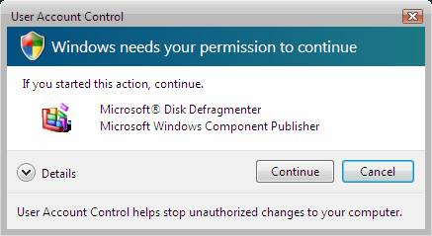
UAC – User Account Control
Elevation prompt for admin users

Slide 12
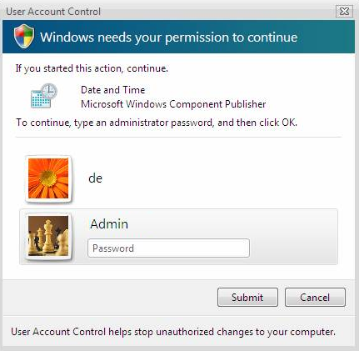
UAC – User Account Control
Elevation prompt for standard users

Slide 13

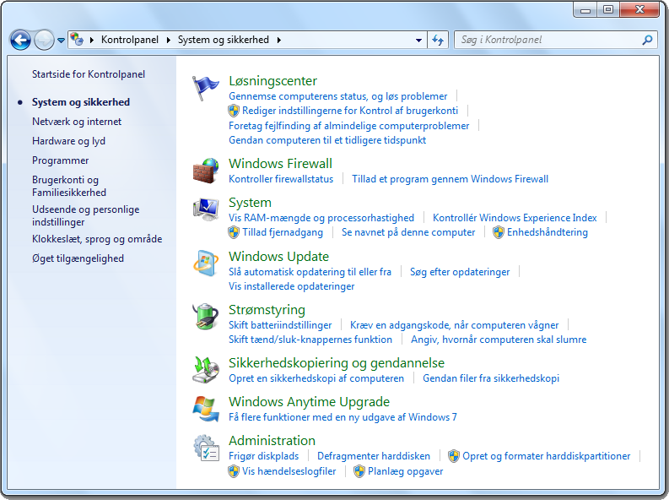
Shield symbol
Indicates that a control require elevated rights

Slide 14
Windows Group Policies
Centralizes management of user and computer configuration settings throughout a network
GPO – Group Policy Object
AD object used to configure policy settings for user and computer objects

Slide 15
Group Policies
Modify default GPOs
Create new GPOs and link to sites, domains and OU
Applied in LSDOU order
Local
Site
Domain
Organizational Units
Settings will be propagated to all users and computers in the container

Slide 16
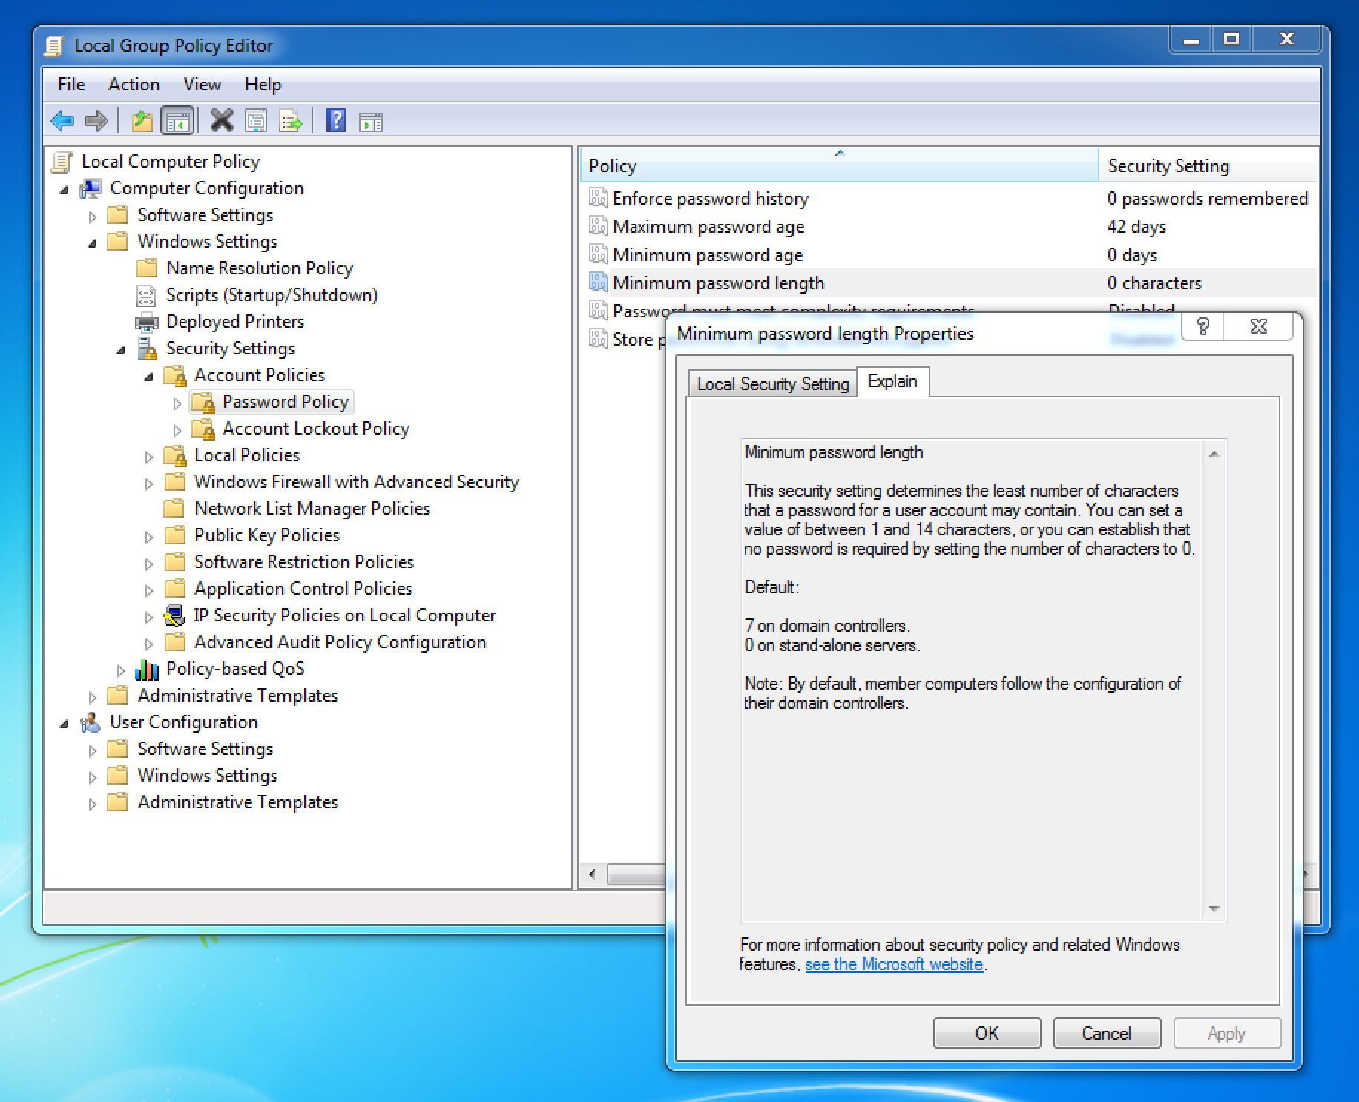

Slide 17
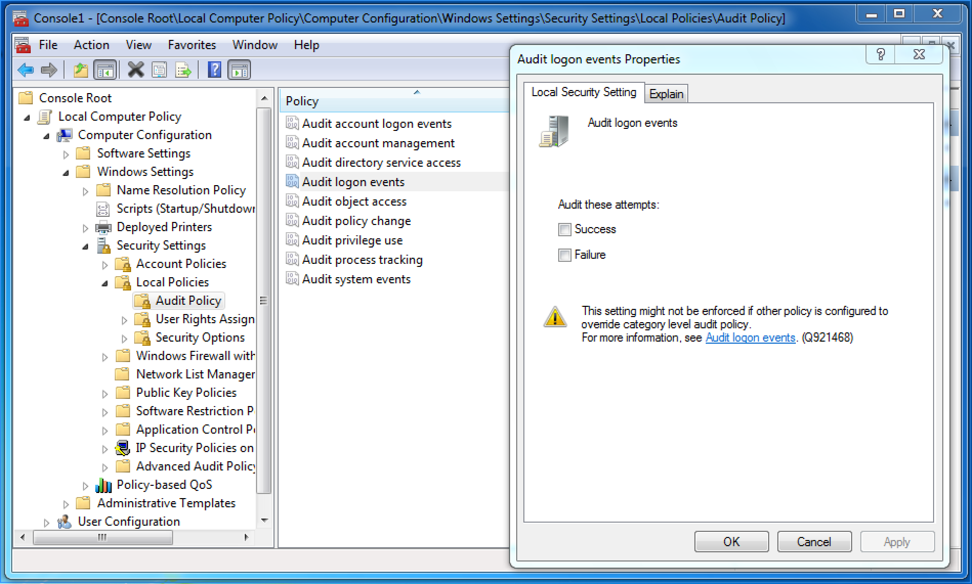
Exercise
Start the GPO editor – MMC snap-in
Run mmc.exe
Add the Group Policy Object Editor Snap-in
Locate the computer auditing policies
Enable auditing of Logon/Logoff events
Verify that the change is working
- lookup audit events in event viewer

Slide 18

Student presentation
Pen testing distrobutions by Jacob Kostecki

Slide 19
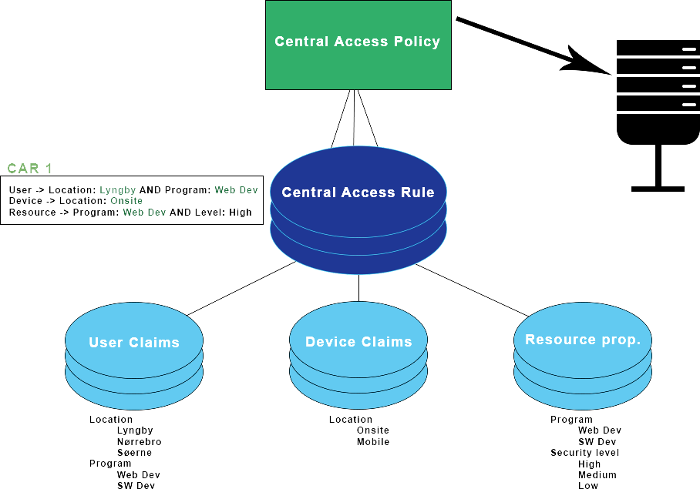
DAC - Dynamic Access Control
Permission management based on rules and claims

Slide 20
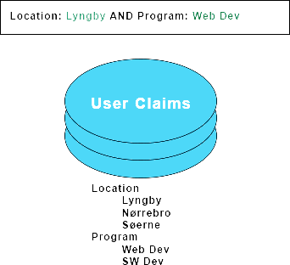
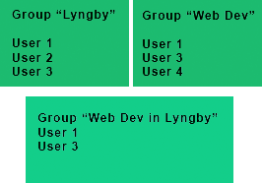
DAC vs ACL
Access rule:
Users from Lyngby AND member of WebDev
Combination of claims/prop.,
Seperation of groups/roles
DAC
ACL

Slide 21
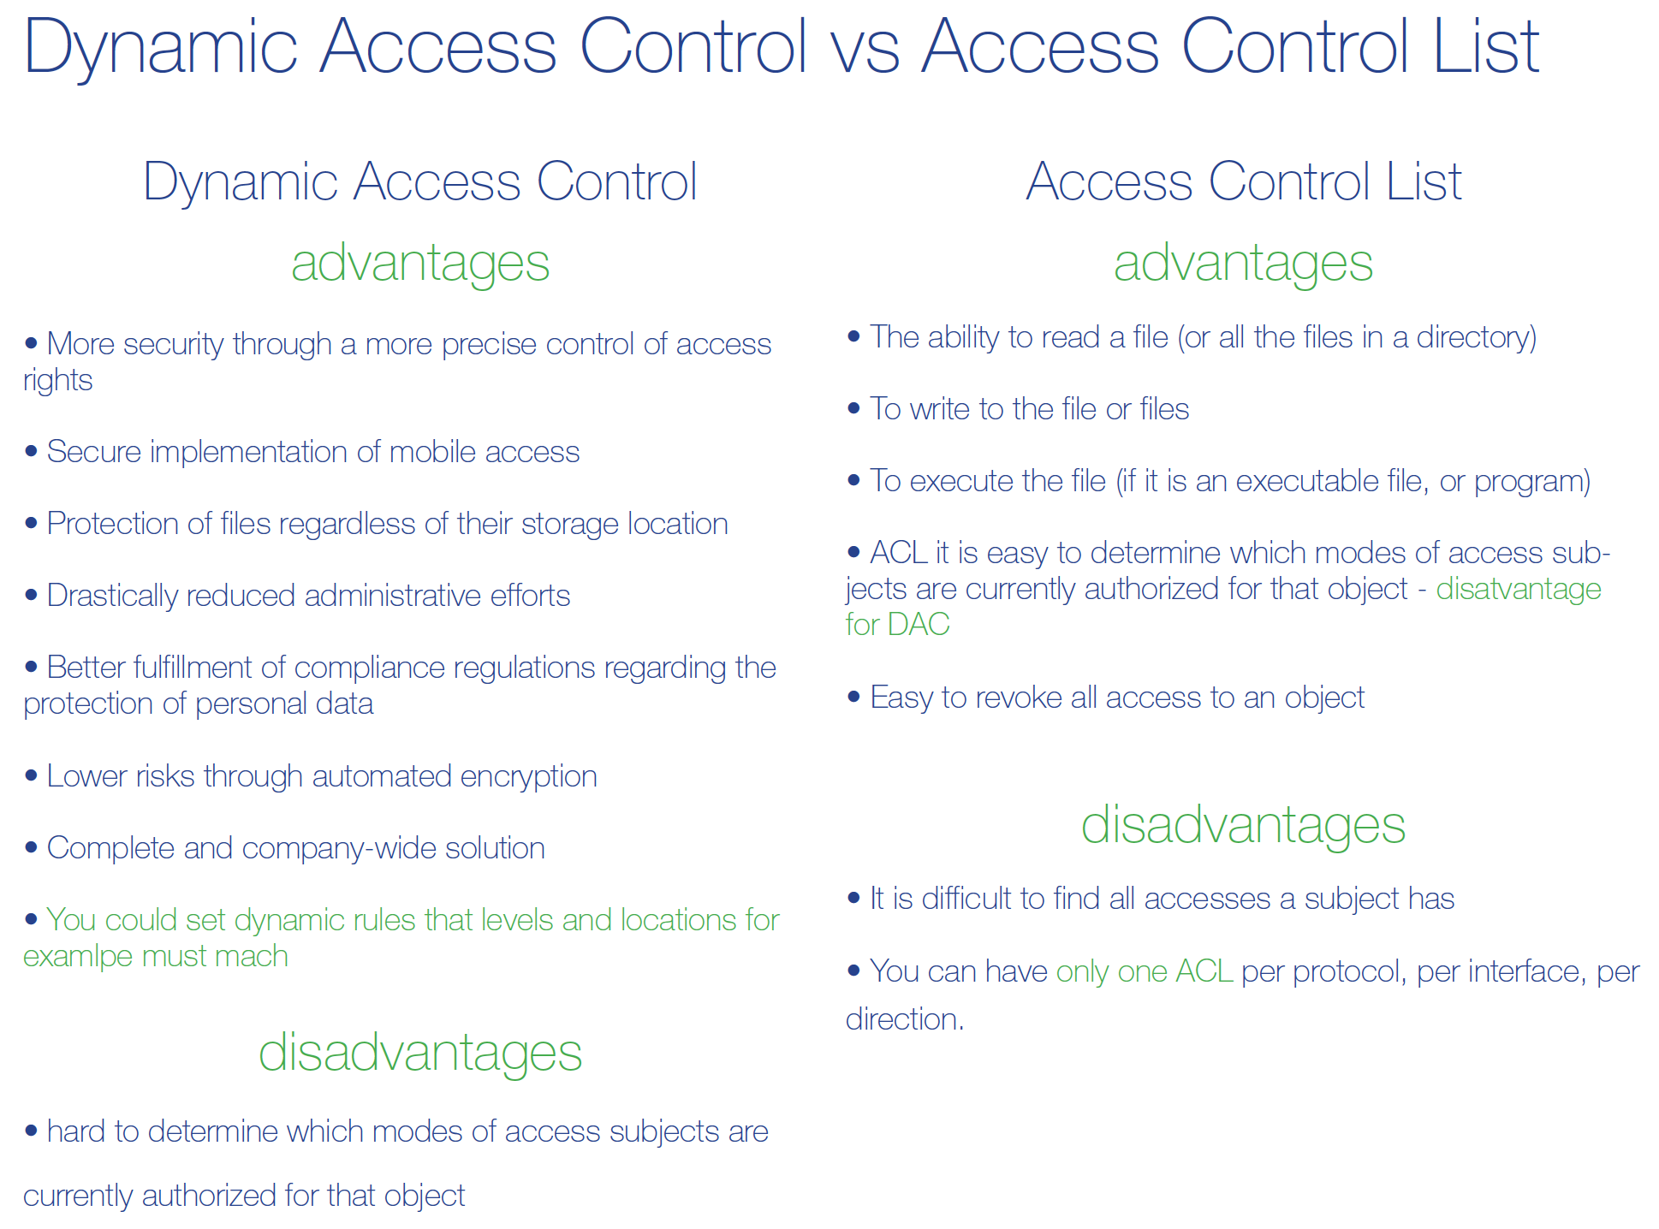

Slide 22
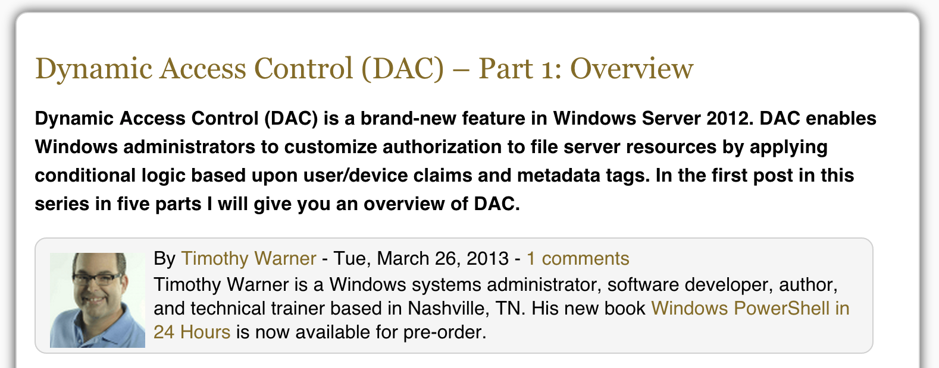
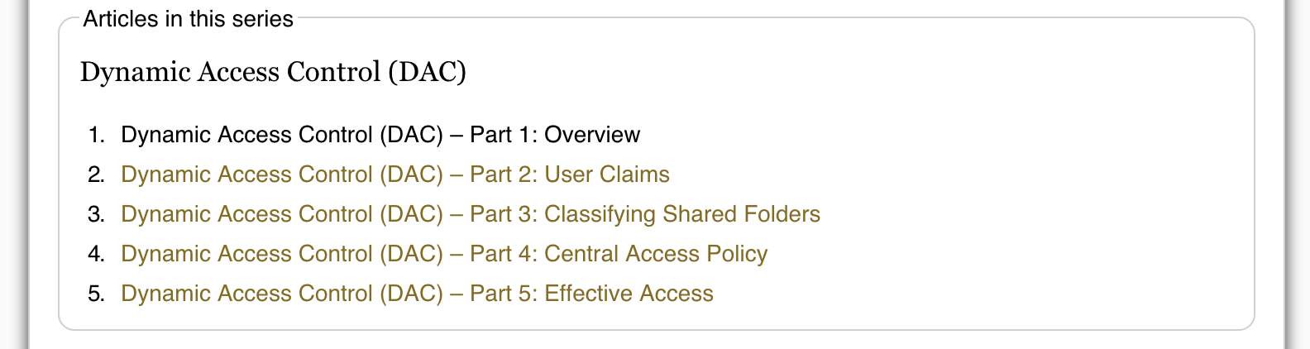
DAC: hands-on
https://4sysops.com/archives/dynamic-access-control-dac-part-1-overview/

Slide 23
Further reading…
CSC : Critical Security Controls - Version 5
https://www.sans.org/critical-security-controls/
CSC 11: Controlled Use of Administrative Privileges
CSC 15: Controlled Access Based on the Need to Know
CSC 16: Account Monitoring and Control

Slide 24
Assignment
Describe yout organisation (or parts of it):
What roles exist?
Need for system access for the different roles
What do you do now to controll access to data? - is it enough?
(no deliveries – to be used a basis for discussion next week)

Slide 25
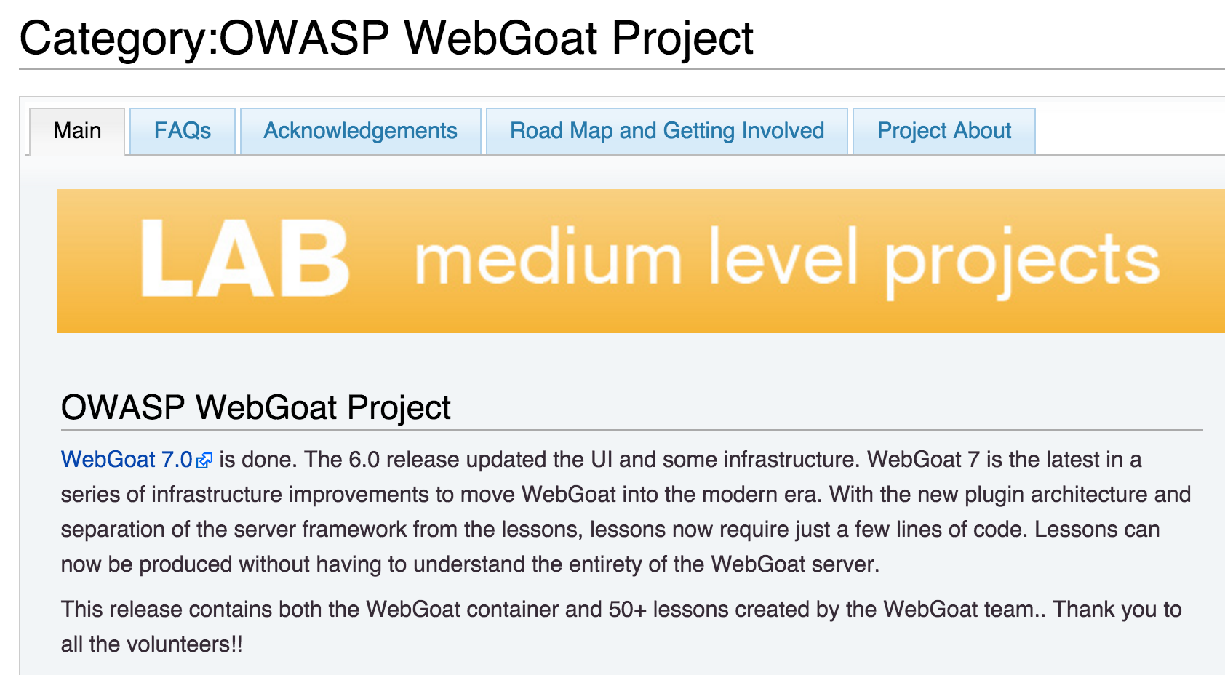
Presentation subject ideas
OWASP WebGoat Project
Cross Site Scripting
SQL Injection
Session security
Token based security
Web Application Vulnerability Scanner

Slide 26
Till next time
Info / literature / links on Fronter – keep updated!!!
Reading:
Cross Site Scripting, WASC-8
http://projects.webappsec.org/w/page/13246920/Cross%20Site%20Scripting
Session Riding, Thomas Schreiber
https://en.wikipedia.org/wiki/Cross-site_request_forgery
https://en.wikipedia.org/wiki/Session_hijacking
https://en.wikipedia.org/wiki/Session_fixation
https://en.wikipedia.org/wiki/SQL_injection
Advanced SQL Injection In SQL Server Applications, Chris Anley

